Slide 1
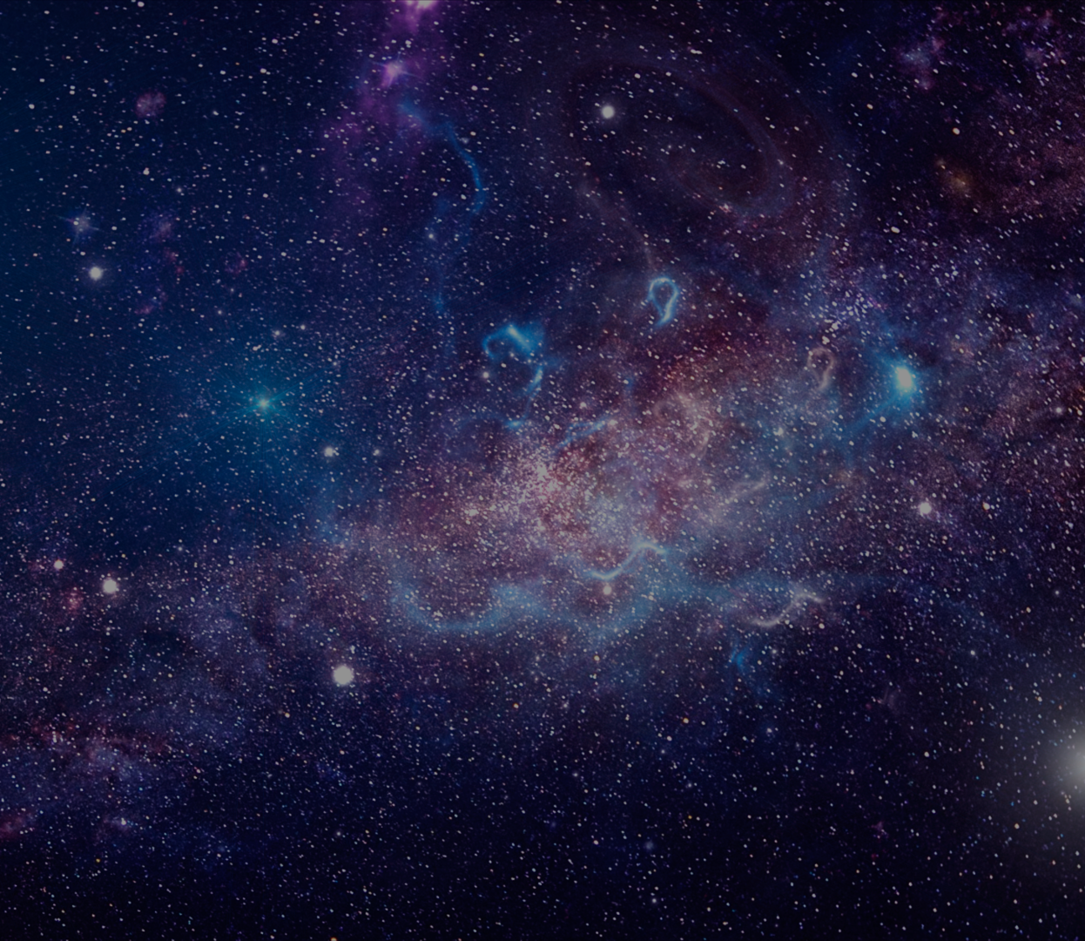
Group 17 Agent-based Modelling (ABM)
Simulating Societal Collapse in
Multi-Generational Space Travel
Tanja Boric​
Verena Grall​
Niklas David Schramm​
Paul Jakob Sedlmayr

Slide 2

Existing Literature
… about space settlements and survival:
“Computing the minimal crew for a multi-generational space travel towards Proxima Centauri b” Marin & Beluffi (2018)
“Minimum Number of Settlers for Survival on Another Planet” Salotti (2020)
“Should and could humans go to Mars? Yes, but not now and not in the near future” Szocik (2019)
“Can Deep Altruism Sustain Space Settlement?” Haqq-Misra (2019)
“… shows that ethical and social virtues, not current technological and medical threats, are the biggest risk for success of the mission.” by Haqq-Misra (2019) cited in Szocik (2019)
Notes:
Relevance of social factors

Slide 3


Motivation
Observe: complex social behaviour.
Complex task: sustaining a society with limited resources for multiple generations
Consider: social / human factors
Take Examples from Lecture:
Dating Choice Model by Kalick and Hamilton (1986)
Simulating Irrational Human Behavior to Prevent Resource Depletion by Sircova, Karimi, Osin, Holme, Strömbom (2015)
Granovetter Threshold Model (1978)
Opinion Dynamics
Notes:
Good example for computational social modelling
Obsere social behavior, especially social and individual factors
As in other models covered in this lecture

Slide 4
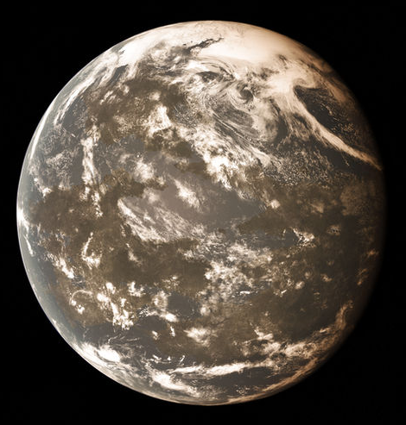

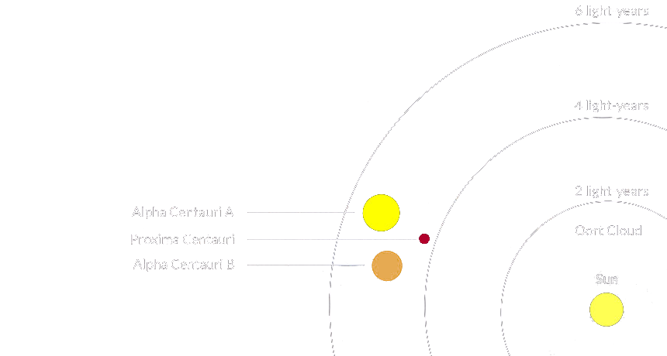
Base Model
Found ABM model with mating logic but without any selectiveness (apart from simple checks) or irrational behaviour:
Model initially based on an astrophysics paper [1]
ABM approach based on Netlogo model [2]
Simulation of long-distance space flight
contains realistic data
parameters set based on research
[1] "Computing the minimal crew for a multi-generational space travel towards Proxima Centauri b" by Marin & Beluffi (2018)
[2] "Simulation of a long-distance space flight" by Sommer & Thorsten (2019)

Slide 5
Base Model
Base Model simulates life on spaceship
Agents: male & female, movement, mating, pregnancy
Parameters: crew size, fertility, age, mating behaviour
Observation mechanics: population over time, accidents, crew demographics, births, deaths
Assumptions: infinite resources, no maintenance needed, simple society & behaviour
Environment: safety zones on ship, accidents occur
Mission Completion Check:
Year 6,300 is reached
overcapacity
or extinction

Slide 6
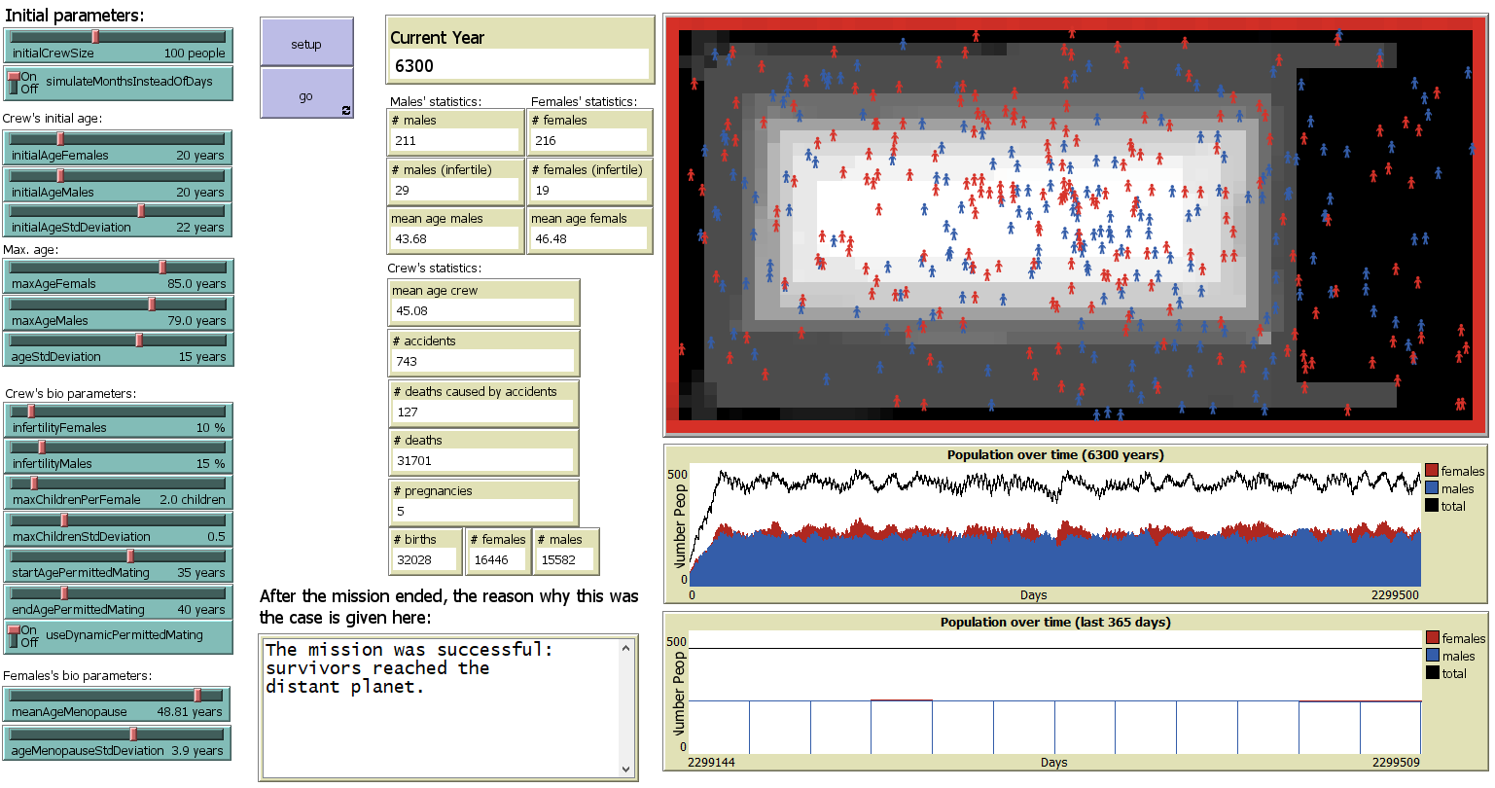
Analysis 1
Base Model (society survives with default parameters)
Stable population over the whole period

Slide 7

Extended Model: with Selectiveness logic
NEW: Determine the probability of mating
Process simulates a more realistic social interaction
Attractiveness-based mate selection simulates mutual consent
Attractiveness value assigned randomly
at birth of each agent (random 0-10)
When two agents meet:
calculate individual differences in values
The smaller the difference, the higher the accept probability (%)
If attractiveness difference is large, the probability of mating decreases, leading to more rejections.
Research Question:
After the introduction of selective dating preferences, ​ at what difference threshold in polarizing view values does the society
go extinct ​because it cannot sustain itself any longer?
​

Slide 8
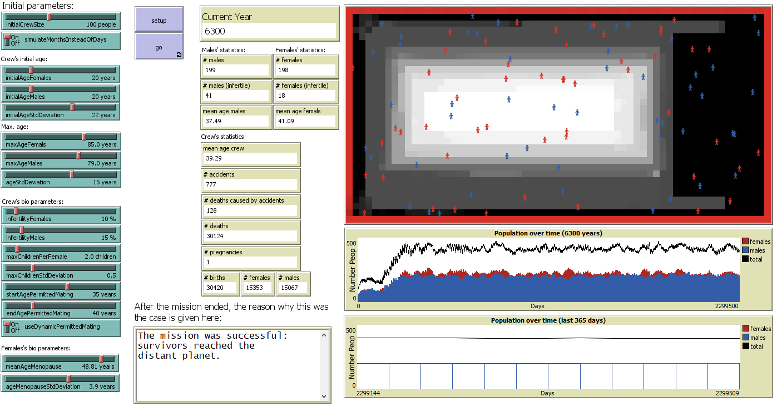
Analysis 2
Extended Model: Base Model that includes selectiveness
Society fluctuates for the first few centuries, but stabilizes over time

Slide 9

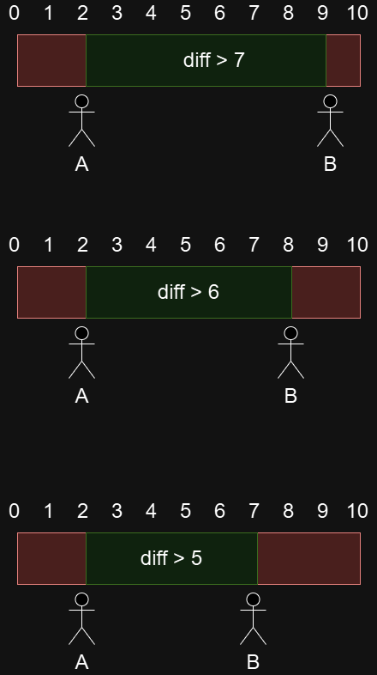
Extended Model: with Polarizing View logic
Representative for opposing views: religious, political, ethical, national, moral, etc.
NEW: Killing possible based on polarizing view differences
Each agent: born with random pv value between 0-10
if two agents meet outside the safety-zone (white) on ship
check differences of polarizing view
if values are too far from each other: one of the two agents can get killed
Example: Agent A has pv value of 2
Depending on threshold of pv difference:
A and B will try to kill each other if the difference is too big
We want to test these diff_thresholds in the remaining slides!

Slide 10
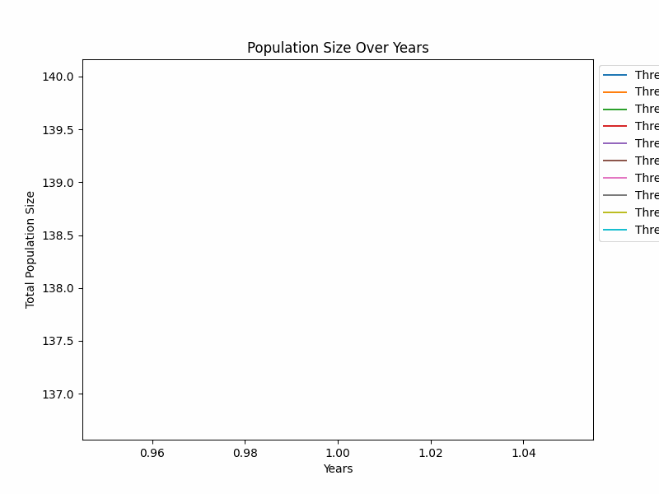
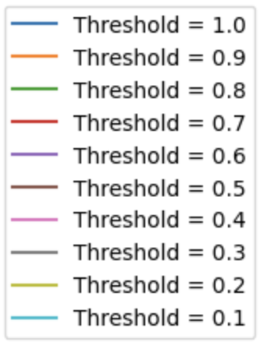

Simulating Populations with Different Thresholds

Slide 11
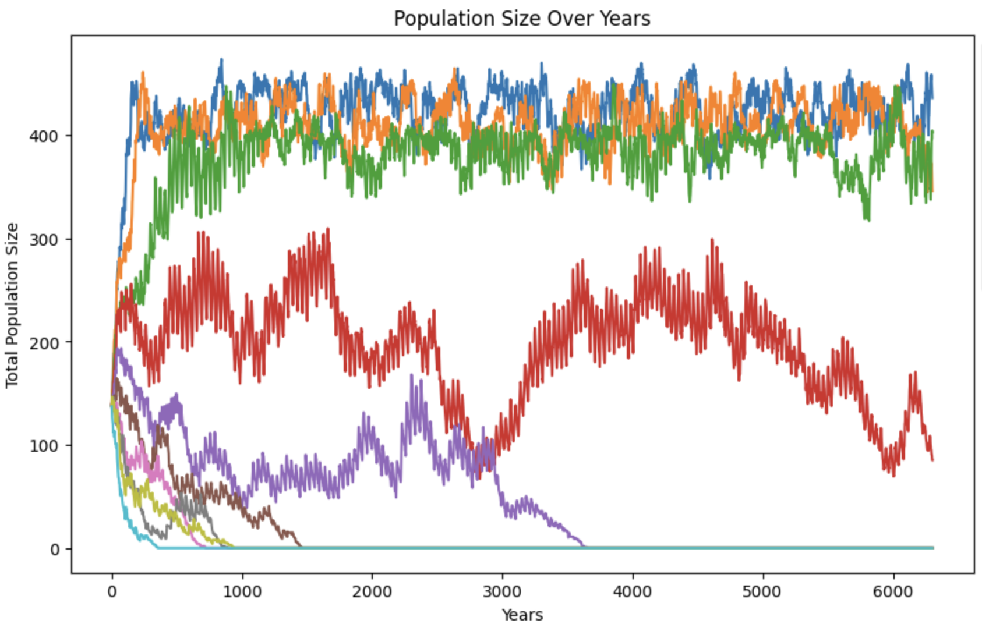
Simulating Populations with Different Thresholds
🪐
🪐
🪐
🪐
☠️
☠️
☠️
☠️
☠️
☠️

Slide 12
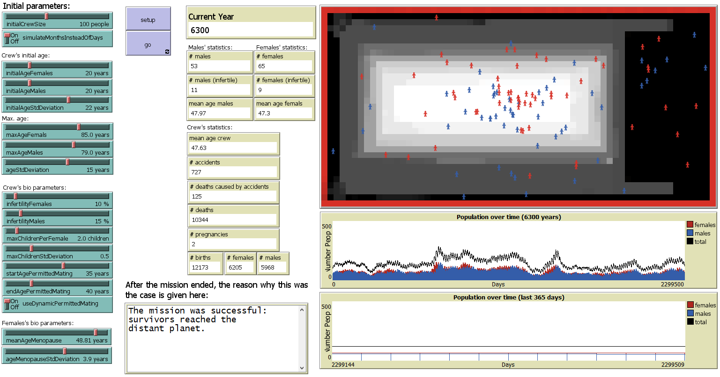
Analysis 3
Extended Model: includes selectiveness &
homicide caused by polarizing views (at view_difference > 7)
Society survives, but there is a visibly lower population growth...

Slide 13
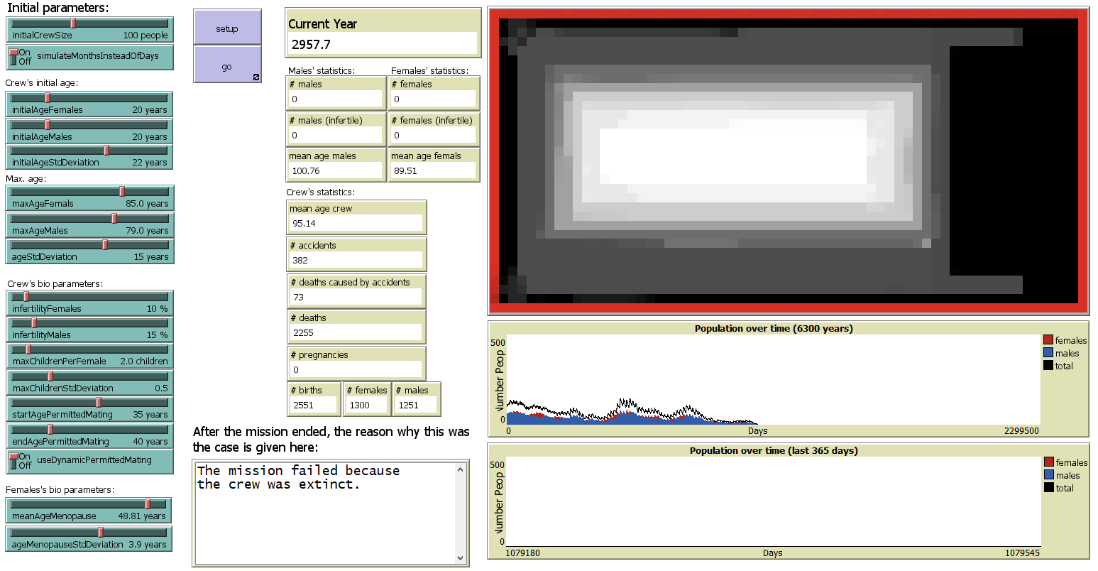
Analysis 4
Extended Model: includes selectiveness & homicide caused by polarizing views (at view_difference > 6)
Spaceship crew goes extinct over time (empty spaceship...)

Slide 14
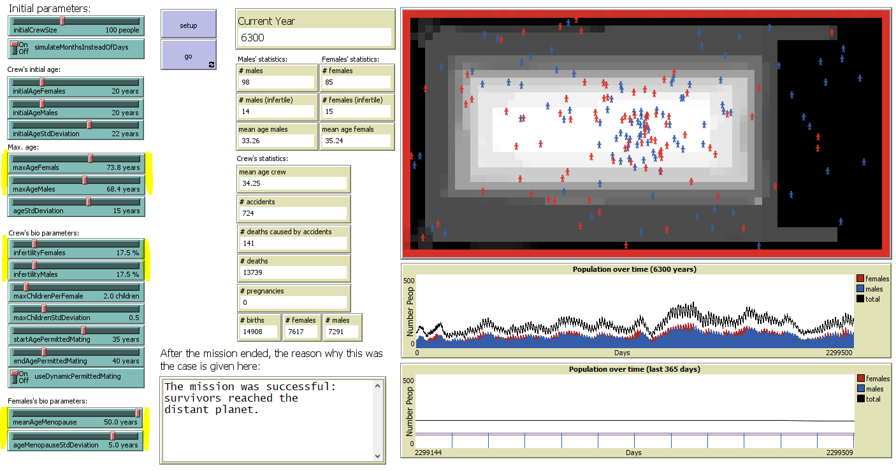
Analysis 5
Extended Model: includes selectiveness & homicide caused by polarizing views
Alternative: with our own parameters (based on background research)
Spaceship crew size fluctuates a lot, but it can survive at treshold 8 (it dies at 7)

Slide 15
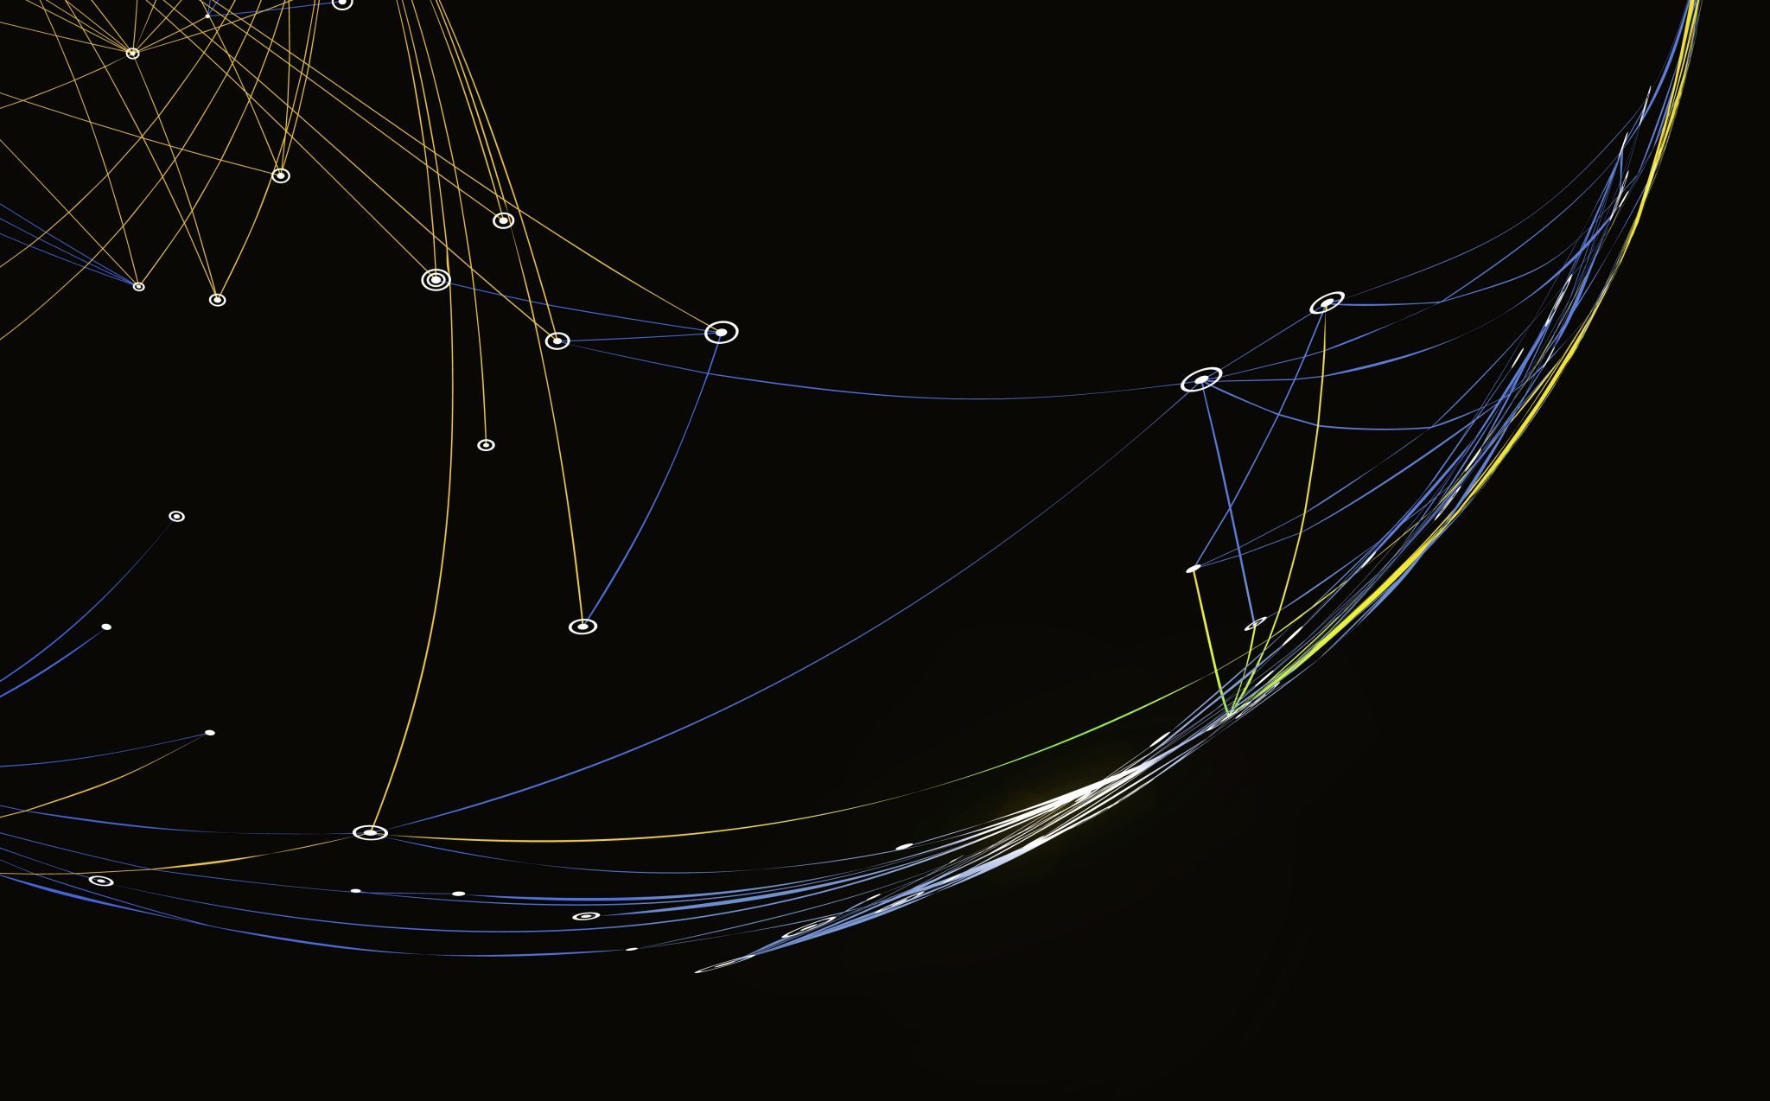
Conclusion
After the introduction of selective dating preferences, at what difference threshold in polarizing view values does the society go extinct because it cannot sustain itself any longer?
Selective mating preferences have an influence on the crew size over time
Extended model incl. attractiveness and polarizing view:
Tested with default parameters: view_difference extinction threshold is between 6 and 7
Tested with our own parameters: survival requires more tolerance. view_difference extinction threshold is between 7 and 8

Slide 16
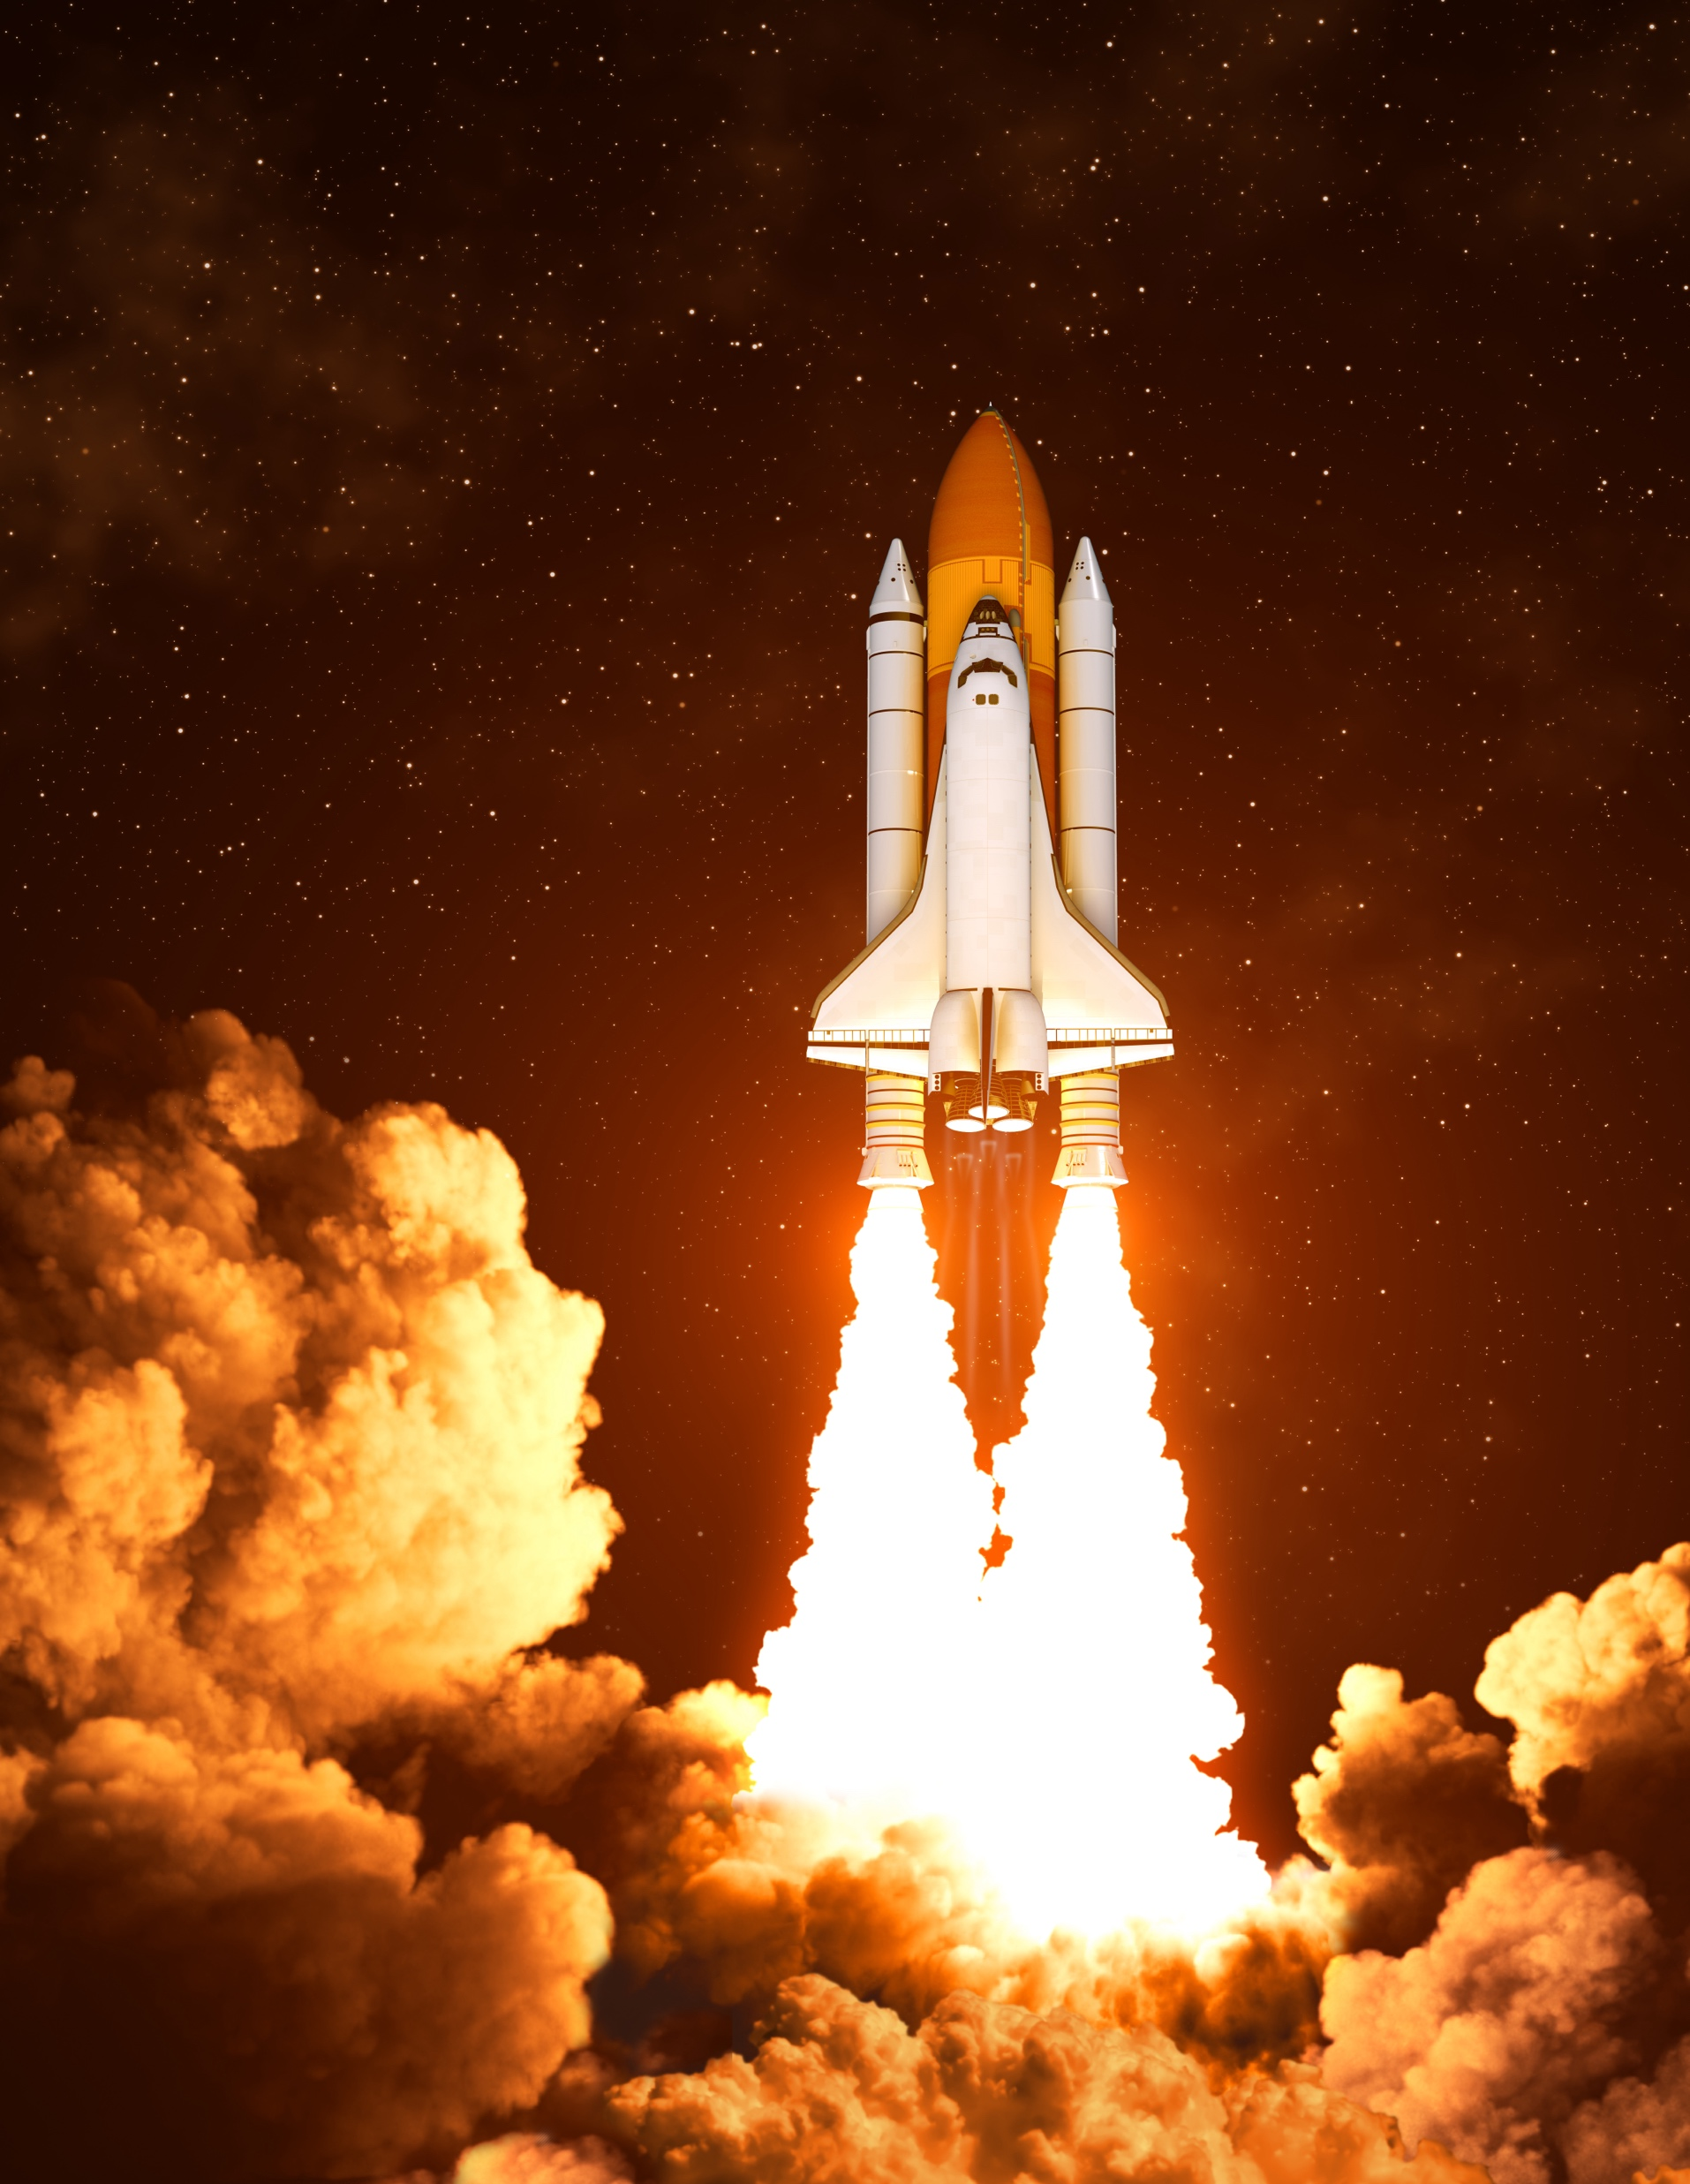
Limitations & Future Research
Computational intensity restricts options
Trying different distributions
of attractiveness
of polarizing view
Different model for mating preferences
e.g. maximizing attractivity
Examining the unique impact of individual variables
ABM modelling of a society is a complex process

Slide 17
Thank you for your attention!
Group 17
References
[1] Github: Simulation of a 6,300-year intergalactic journey https://github.com/SommerEngineering/Simulation-of-long-distance-space-flight?tab=readme-ov-file
[2] Sommer, Thorsten (2019). Simulation of a long-distance space flight. DOI: 10.5281/zenodo.3382912
[3] Sommer, Thorsten (2019). Simulation of a 6,300-year intergalactic journey. DOI: 10.17504/protocols.io.676hhre
[4] Experiment of Frédéric Marin and Camille Beluffi from 2018: https://arxiv.org/abs/1806.03856
[5] Sircova A, Karimi F, Osin EN, Lee S, Holme P, et al. (2015) Simulating Irrational Human Behavior to Prevent Resource Depletion. PLOS ONE 10(3): e0117612. https://doi.org/10.1371/journal.pone.0117612
[6] Kalick, S. M., & Hamilton, T. E. (1986). The matching hypothesis reexamined. Journal of Personality and Social Psychology, 51(4), 673–682. https://doi.org/10.1037/0022-3514.51.4.673
[7] Szocik, K. (2019). Should and could humans go to Mars? Yes, but not now and not in the near future. Futures, 105, 54–66. https://doi.org/10.1016/j.futures.2018.08.004
[8] Salotti, J.-M. (2020). Minimum Number of Settlers for Survival on Another Planet. Scientific Reports, 10(1), 9700. https://doi.org/10.1038/s41598-020-66740-0
[9] Haqq-Misra, J., Wolf, E. T., Welsh, W. F., Kopparapu, R. K., Kostov, V., & Kane, S. R. (2019). Constraining the Magnitude of Climate Extremes From Time-Varying Instellation on a Circumbinary Terrestrial Planet. Journal of Geophysical Research: Planets, 124(12), 3231–3243. https://doi.org/10.1029/2019JE006222
[10] Marin, F., & Beluffi, C. (2018). Computing the minimal crew for a multi-generational space travel towards Proxima Centauri b (Version 1). arXiv. https://doi.org/10.48550/ARXIV.1806.03856
[11] Haqq-Misra, J. (2019). Can Deep Altruism Sustain Space Settlement? In K. Szocik (Ed.), The Human Factor in a Mission to Mars (pp. 145–155). Springer International Publishing. https://doi.org/10.1007/978-3-030-02059-0_8

